Slide 1
Fluid Simulation for Climate Impact with Navier-Stokes
https://devpost.com/software/fluid-sim

Slide 2
INTRODUCTION
A tool that could help us better understand and simulate the behavior of air, smoke, and smog - complex fluids that play a critical role in our environment and our health.
Simulates the reaction of a fluid with varying viscosity after a user induces a temperature change.
Allows the user to configure simulation parameters: TIMESTEP, VISCOSITY, DECAY, RADIUS.

Slide 3
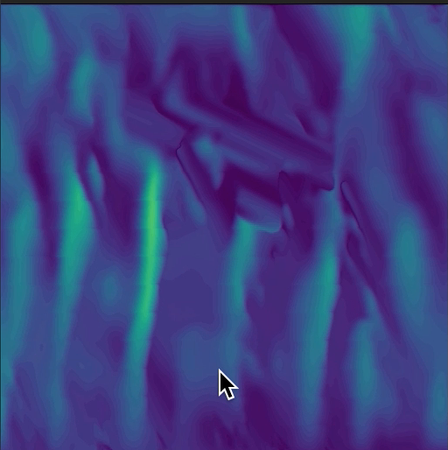
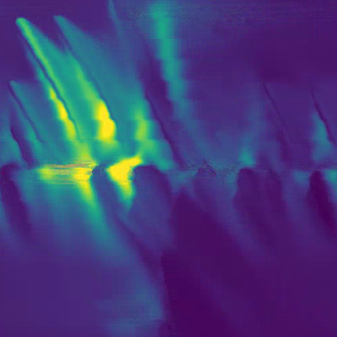
Technical details
Encapsulate the state of the fluid by a velocity vector field and a scalar pressure field.
Invoke CUDA kernel “nskernel” to compute the velocity and pressure values at each pixel through a five step process.
Invoke CUDA kernel “clrkernel” to map velocity vectors to RGB values so that they may be rendered.
Render the results in real-time with OpenGL.
Air-like fluid
Smog-like fluid

Slide 4
nskernel
Advection
Diffusion
Force Application
Poisson-Pressure
Projection

Slide 5
demonstration
https://youtu.be/ZlRuxI-4WbQ
https://youtube.com/shorts/-zmT2wl-XpA
Live Demo
$ nvcc fluids.cu -o ./out -lglfw -lGLU –lGL
$ ./out TIMESTEP VISCOSITY DECAY RADIUS

